Slide 1
The Basics on Articles and Prepositions (In, On, At).

Slide 2
What are articles?
According to the Merriam-Webster dictionary online, grammatical articles are:
  “Any of a small set of words or affixes (as a, an, and the) used with nouns to limit or give definiteness to the application.”
  In other words, articles are words that occur before nouns to describe or determine the noun (e.g. specific/non specific).
    The singular indefinite article is a or an.
    The plural indefinite article is some.
    The definite article is the.

Slide 3
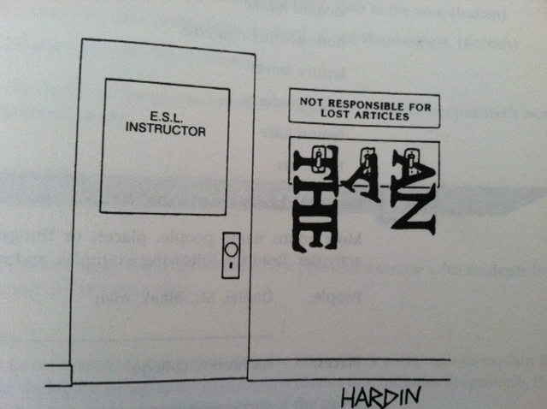

Slide 4
When do we use articles?
We use articles before common nouns.
  Common nouns are non-specific (i.e. people, places, things, and ideas).
People | Places | Things | Ideas
mom | garage | stove | development
dad | house | kitchen | analysis
sister | store | oven | solution
brother | yard | microwave | collection

Slide 5
Singular Common Count nouns
Indefinite articles occur before singular nouns that are countable things. A/an is roughly equivalent to one.
  A boat=one boat
If the article occurs before a noun with a vowel sound you would use an.
  An apple a day keeps the doctor away.
    If the article occurs before a noun with a consonant sound you would use a.
      A uniform is worn at many schools.
      A cat is sleeping on the couch.

Slide 6
Common Count Nouns
Common Nouns: If the common nouns are also count nouns they can take the indefinite and definite articles in all forms a/an, ø (no article) some, the depending on the situation.
Correct Use | singular/plural | Incorrect use | singular/plural
an apple | singular | an apples | plural
the apple(s) | singular/plural | a apple | plural
apples | plural (ø) | a apples | plural
a boat | singular | an boat | singular
some apples | plural | some apple | singular
some boats | plural | some boat | singular

Slide 7
When do we use articles?
We also use articles before proper nouns. Proper nouns are specific (i.e. names of people, places, or things)
Names of People | Names of Places | Names of things
Whitney Houston | Los Angeles | St. Patty’s Day
Michael Jackson | Paris | Golden Retriever
Johnny Depp | Hurst Castle | General Motors
Dr. Furtado | The Lost Coast | La-Z-Boy

Slide 8

Proper Nouns
Proper Nouns: Take either the definite article the or no article ø. They are inherently definite. They can never take the singular indefinite article. These nouns are an exception to the previous rule because they are countable but can never take the singular indefinite article.
Correct Use | singular/plural | Incorrect Use | singular/plural
The Golden Retriever is a friendly dog. | singular | Golden Retriever is a friendly dog. | singular
Dr. Smith is a good professor. | singular | A Golden Retriever is a friendly dog. | singular
Golden retrievers are friendly dogs. | plural | A Dr. Smith is a good professor. | singular

Slide 9
Non-Count Nouns
Non-Count nouns are non-countable (i.e. you can’t say one furniture). They are singular in subject, they do not take the indefinite article a/an nor do they have plural inflection. Non-Count nouns may take the indefinite article some, the definite article the, or no article ø.
Correct Use | singular/plural | Incorrect Use | singular/plural
the furniture | singular | the furnitures | plural
furniture | singular | furnitures | plural
the information | singular | the informations | plural
information | singular | informations | plural
some furniture | singular/plural | a information | singular
some information | singular/plural | a furniture | singular

Slide 10
The Count and Non-Count Distinction
The distinction between the two types of nouns is problematic for ESL/EFL learners because countability and non-countability is somewhat arbitrary.
  Look at the previous examples of non-count nouns:
        Furniture
        Information
  In English these are considered non-count nouns but in Spanish and French they are count nouns.

Slide 11
Non-Count and Count Nouns
Both plural count nouns and non-count nouns can take the indefinite plural article some or no article ø. If a count noun takes ø it has a plural inflection.
Non-Count Nouns | singular/plural | Count Nouns | singular/plural
water | singular | beverages | plural
some water | singular/plural | some beverages | plural
luggage | singular | suitcases | plural
some luggage | singular/plural | some suitcases | plural

Slide 12
The Meanings of the Indefinite Article a/an
We use the indefinite article to:
  1. Introduce new information into the discourse. For example, use the indefinite article a/an before a count noun if it’s the first sentence of a paragraph.
      I ate an apple on Wednesday.
  2. We also use the indefinite article a/an in non-specific noun phrases, where the identity of the noun is unknown.
      Let’s rent a movie.

Slide 13
The Meanings of Some and No Article ø
Non-Specific noun phrases can also be marked with some and ø (no article) if the noun is plural.
  Sugar makes candy delicious (non-count)
  I need some stamps (plural count noun)
  I need stamps. (plural count noun)
  The difference between some and using no article is that ø represents an unspecific quantity. On the other hand, some imposes a number of stamps even though the amount is still unspecific.

Slide 14
Other Uses of Some
Watch out for some because it does not always function as an article; sometimes it functions as a determiner that is stressed.
  Particle/quantitative use: Some of the cats ran out of the house.
  Emphatic: That was some party!
  Presentative: Some guy came to the door who wanted to come to the party. (Some=a certain one and often conveys a negative meaning or affect).

Slide 15
The Meanings of the Definite Article
Most instances of the definite article are non-generic meaning they are specific.
Uses of the are usually specific to a particular community or include a set of shared knowledge.
Now let’s look at how we use the in discourse.

Slide 16
The meanings of the Definite Article
We use the definite article the to:
  1. Express old information: recall in the first example of using the indefinite article a/an for new information, in which some brand new noun was being introduced into the discourse. If that noun is expressed again, use the definite article to show that the information is already known.
      I ate an apple on Wednesday. The apple was red, juicy, and delicious.

Slide 17
The meanings of the Definite Article
We also use the definite article when:
  2. The general community understands the noun as common knowledge:
      The Sun, The moon, The Earth
  3. Immediate Situational Use:
      Don’t go in there. The stench is awful.
  4. Perceptual situational use: the noun is visible, audible, etc.
      Pass me the salt, please.
  5. Local use: General knowledge or information: includes members of the same community.
      The museum, the church, the bar

Slide 18
The meanings of the Definite Article
  6. Local use: specific knowledge or information--includes members of a specific community. This knowledge belongs to people in a smaller, private community (e.g. family or friends). But this reference would exclude members outside that community.
      Husband: Where are the keys?
      Wife: The keys are in the kitchen.

Slide 19
Modifiers between Articles and Nouns
Writers may use modifiers, such as nouns and adjectives, between the article and the noun to specifically modify or describe the head noun.
  A. One or several adjectives may appear between the article and the head noun.
    The journalist wrote the story.
    The journalist wrote the top story.
    The journalist wrote the first top story.

Slide 20
Modifiers between Articles and Nouns
  B. One or more nouns can modify a head noun and appear between the article and the head noun.
      The journalist investigated the story.
      The journalist investigated the town’s story.
      The journalist investigated the town’s homicide story.
  C. Finally an adjective and a noun can modify a head noun and appear between the article and the head noun.
      The journalist began to investigate a story.
      The journalist began to investigate a new story.
      The journalist began to investigate a new town’s story.

Slide 21
Conclusion of Articles
That concludes the presentation on articles. Now let’s turn to some article activities!

Slide 22
The Prepositions In, On, and At
While there are many other more complex prepositions besides in, on, and at, these are some of the most widely used prepositions.
Understanding the concrete and abstract uses will help ESL/EFL learners understand how to use prepositions appropriately.
Prepositions occur before a noun or noun phrase (e.g. at the house). They can occur at the beginning or end of sentences. Although we see them more often at the end of sentences.

Slide 23
The Preposition In
Spatial uses of in:
  In is used for something contained (often in a space):
    There was a bug in the room.
    The child was in the store searching for his mom.
Uses of in with time:
  In precedes times of the day, months, years and seasons:
    She likes to play music in the evening.
    The days are shortest in December.
    The movie came out in 1994.
    The ocean will be warm in spring.

Slide 24
The Preposition In
Idiomatic uses of in:
  Future appointments:
    Come in 10 minutes so we can squeeze you in.
  Currency:
    You have to pay me in dollars.
  Language:
    Could you explain it in English, please?

Slide 25
The Preposition On
Spatial uses of on.
  On is used to discuss the location of something on a surface or a line:
      I left the keys on the table.
      The folder is on the desk.
      A: Where are the keys?
      B: On top of the dresser.
Uses of on with time.
  On is used with days:
      I will see you on Friday.
      The concert is on Saturday.

Slide 26
The Preposition On
Idiomatic Uses of On.
  Communicative:
      I listened to it on the radio.
      I watched the news on T.V.
  Concerning something:
      I read a book on magic.
      The lecture was on modern art.
      I worked on my homework all night.

Slide 27
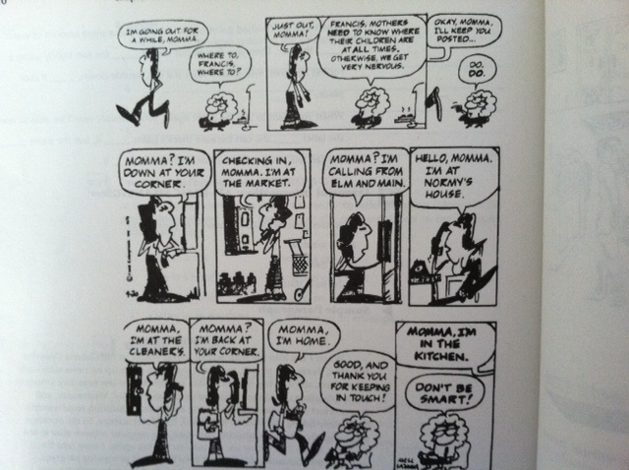

Slide 28
The Preposition At
Spatial/Directional uses of at:
  At precedes a point of intersection:
      We were waiting at the corner for the bus.
  At precedes a general area:
      Let’s meet at the movie theater.
  At precedes a target:
      I threw a shoe at the alarm clock.
Uses of at with time:
  At precedes a specific time of day.
    My plane arrives at 7:00 p.m.
    The movie starts at noon.
    At midnight, I have to be in bed.

Slide 29
The Preposition At
Use of at with a relative amount.
  Degree/Temperature:
    Water freezes at 0 degrees.
  Age:
    My dad will retire at 65.
Idiomatic uses of at.
  State/Condition/engagement of a particular activity:
    She works hard at maintaining her figure.
    He is amazing at acting.
    I’m rarely at ease when taking a test.
  Indicates a cause or a source of an action or state:
    He frowned at the thought of marriage.
  Indicates a skill:
    I am the master at linguistic analysis.

Slide 30
Resources
Preposition resource:
http://owl.english.purdue.edu/owl/resource/594/01/
Article resource:
http://owl.english.purdue.edu/owl/resource/540/01/

